Slide 1
Congregational Federation
Independent Review
Sue Heatherington & Janet Russell
National Assembly
9th June 2018

Slide 2
Introduction
What we were asked to do:
  Review the restructuring and redundancy process
  Support the healing of relationships
What we have done:
  Talked, read, thought, probed and prayed a lot…
  Held a Roundtable with the participants on 22nd May
Outline of today:
  Presenting our conclusions and exploring the underlying causes
  Meeting God and moving toward healing
  Looking ahead

Slide 3
Headline conclusions
No evidence of anything illegal
No evidence of intentional wrong doing
But this is a ‘train crash’ with serious damage
And it was inevitable…
For those who wanted simple, right answers, with straightforward solutions – welcome to the messy world of complex reality and humankind, we are all here!

Slide 4
The redundancy process
Technically legal – but open to challenge
Sadly, could have been done much better:
Good practice
  Meaningful consultation, timelines, and tone
Decision-making
  Lack of impact and risk assessment, inconsistency
Duty of care
  Support, mixed messages, impact, and leadership
Alignment with CF values
Expedient and not generous

Slide 5
Restructuring Congregational Fed.
Technically not illegal – but open to challenge
Should have been done better
Reactive
  Financial orientation (eg shift Nov’14-Mar’15), timing, limited risk and impact assessment
Governance failure
  Void, clarity of roles, competence/capacity, influence of the few, Chair roles, decision-making
Communication
  Confidentiality v secrecy, trying… but lacking insight
Driven not vision nor strategic

Slide 6
Recap
No evidence of anything illegal
No evidence of intentional wrong doing
But this is a ‘train crash’ with serious damage
And it was inevitable…
You can’t change what happened,
though you can learn…
But you need to address WHY this happened
– it’s your collective responsibility!

Slide 7
Underlying causes
TRUST
Governance
Culture
Reality
Plus complexity of multiple entities: independent churches, ‘areas’, the charity (Congregational Federation), the trustee company (CF Ltd)

Slide 8
Governance gap – our views…
How decisions are made & people held to account
Intentional ‘looseness’ – 1972 constitution
  Organic/reactive, first generation, and of its time
Current void and confusion – inadequate for now
  Role and authority of Council and Assembly, and clarity of individual roles
  Appointment to Council, trusteeship and conflicts of interest
  Accountability and stakeholders
  Clarity of purpose – why does Congregational Federation exist?

Slide 9
Culture – your narrative…
Independent | Spirit-filled | Damaged
Repairable | Disconnected | Diversity
Dysfunctional | Hopeful | Myopic
Dissenting | Christ-centred | Tribal
Unmotivated | (Loose) Unity | ‘Us and them’
In pairs: choose a word that in your experience most describes CF now. Explain why you chose it. What does this tell you?

Slide 10
3. “Under the circumstances…”
The relentless march of reality:
  Traditional churches in significant decline
  Massive increase in requirements and expectations
  “Need more to stand still…”
  Western culture of sound bites
  Healthy aspiration v ‘get real’
Consequences:
  ‘The last one standing…’ – work lands on the few
  Individuals acting under extreme pressure...
  Wisdom is traded for action

Slide 11
Mutual trust has broken down
Elements that make up trust (Stephen MR Covey):
  INTEGRITY
  INTENT
  COMPETENCE
  CREDIBILITY
Individually - on a scale 1-10 rate CF for each element when you first got involved with CF and now. What do you notice?

Slide 12
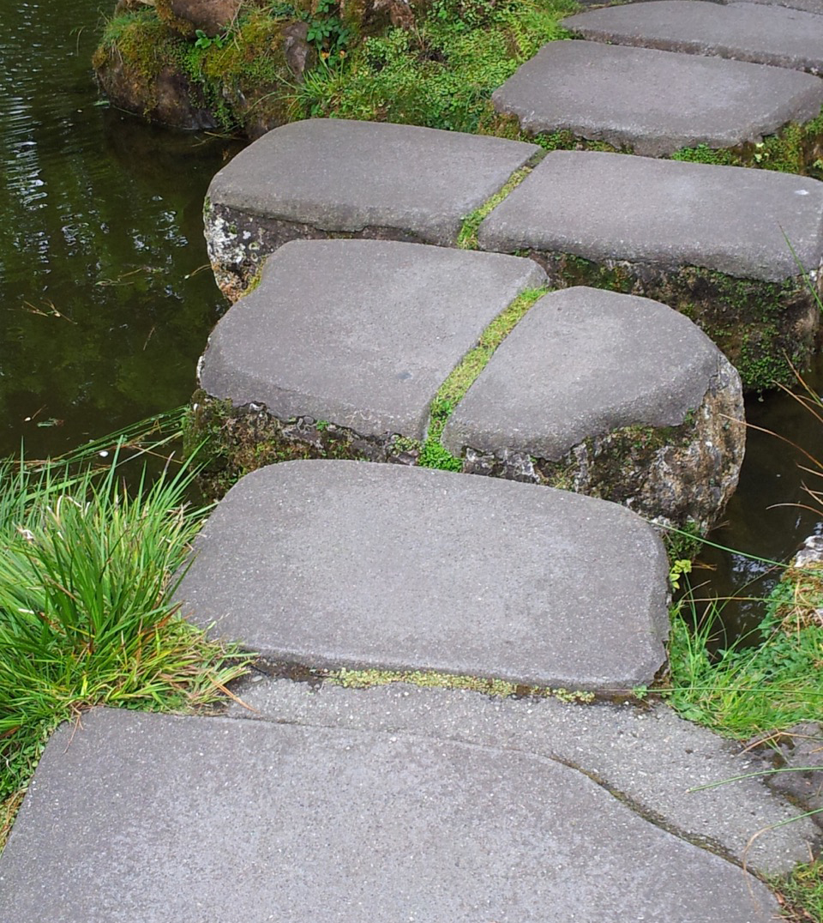
Invitation to meet God together
In prayer and worship for healing and peace
Acts 6: 1-7 (NIV)
Reflective prayer…
Forgive as we forgive - sonnet by Malcolm Guite from Parable and Paradox, Canterbury Press, 2016

Slide 13
Prayers of confession
Forgive us, Lord.
Today I, __________ (please state your name aloud)
acknowledge that I have held onto feelings
about people in the Congregational Federation
that are hurtful to me, to them, and to our Congregational values.
Forgive me, Lord.

Slide 14
Prayers of confession - 2
Heal us, Lord.
Help me to release all resentments and hardness of heart.
Heal me, Lord.
Heal us, Lord.
Help me to release the blame that I have placed on others.
Heal me, Lord.

Slide 15
Prayers of confession - 3
Heal us, Lord.
Help me to stop the events of the past having power over my present, or the life of our Church.
Heal me, Lord.
Heal us, Lord.
Help me to let go of anything that keeps me frozen in the past;
keep me from returning to memories of hurt.
Heal me, Lord.

Slide 16
Prayers of confession - 4
Heal us, Lord.
Help me to let go of all thoughts of vengeance or revenge.
Heal me, Lord.

Slide 17
Prayers of confession - 5
Heal us, Lord.
Help me to let go of any patterns of behaviour that could be destructive to our Body,
to any member of it,
or to myself.
Heal me, Lord.
Heal us, Lord.
Help me to let go of the need to be right.
Heal me, Lord.

Slide 18
Prayers of confession - 6
Heal us, Lord.
Help me to discern and accept your solutions for our future.
Heal me, Lord.
Heal us, Lord.
If I stray from the path of reconciliation and peace,
help me to find my way back; again and again.
Help me, Lord.

Slide 19
Prayers of confession - 7
Forgive us, Lord.
I ask your forgiveness for any part I have played
in perpetuating division through careless acts, words or deeds.
Forgive me, Lord.

Slide 20
Collective prayer from Hosea 6…
Come, let us return to the Lord and say:
Lord our God,
in our sin we have avoided your call.
Our love for you is like a morning cloud,
like the dew that goes away early.
Have mercy on us;
deliver us from judgement;
bind up our wounds and revive us;
in Jesus Christ our Lord. Amen.

Slide 21
Closing together...
May the God of all healing and forgiveness
draw you to himself,
and cleanse you from all your sins
that we may behold the glory of his Son,
the Word made flesh,
Jesus Christ our Lord. Amen.
Time for reflection on the confessions we have made…
Abba Father, let me be
yours and yours alone.
May my will forever be,
ever more your own.
Never let my heart grow cold, never let me go.
Abba Father, let me be
yours and yours alone.
Dave Bilborough © ThankYou Music
The Grace...

Slide 22
Looking ahead
Working with the underlying causes:
Governance void – being clear on why CF exists now as well as how you do it
Culture – really hearing what its like to be here – response from the day
Facing reality – with honesty and hope
Rebuilding trust – what will it take on all sides?

Slide 23
Congregational Conversations
What are the big questions for you collectively as Congregational Federation?
Who needs to answer or be engaged with them?
How is the best way of doing this?

Slide 24
Looking ahead
This is just the beginning…

